Slide 1
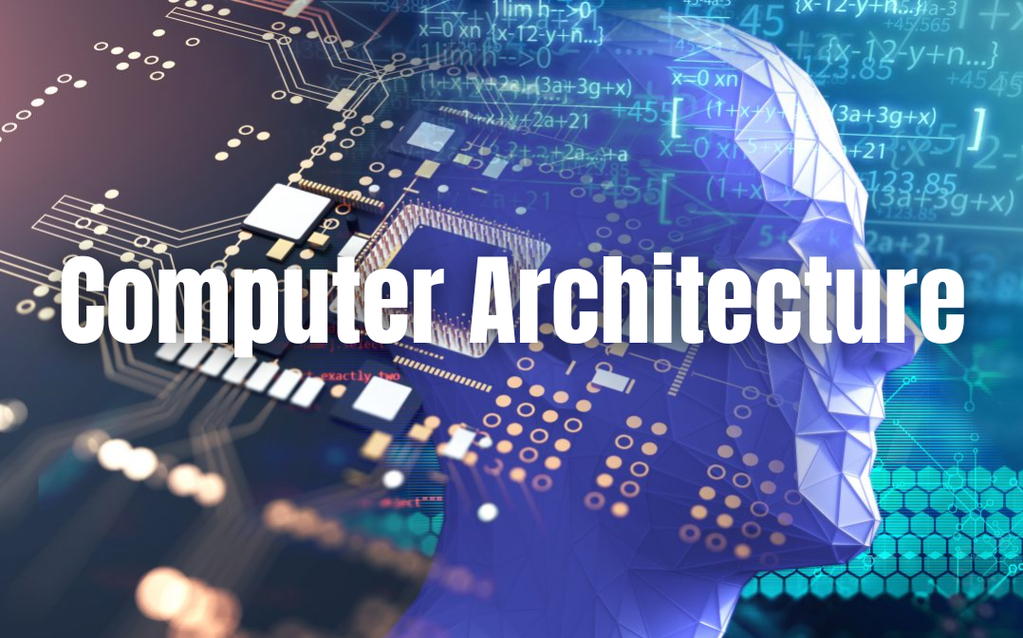
2.1 Explained decently

Slide 2
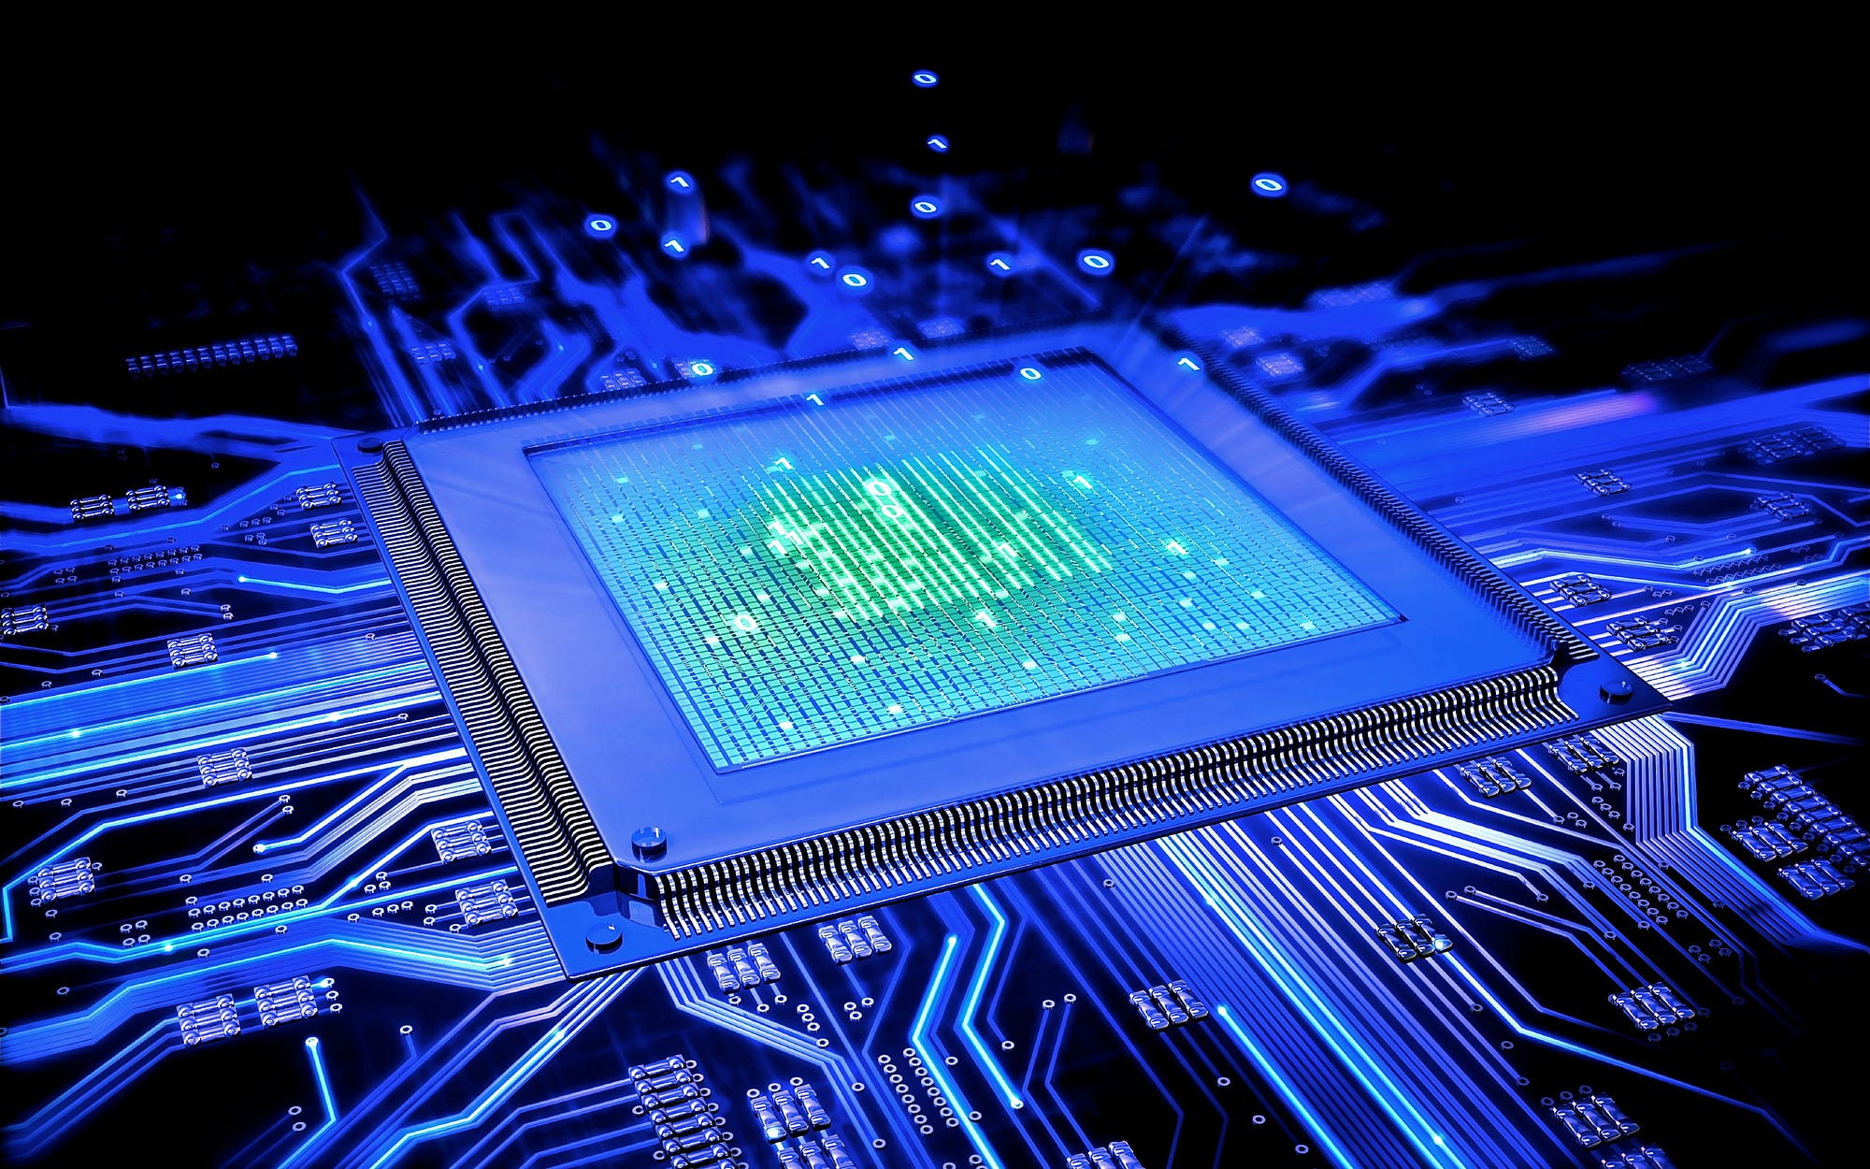
What is computer architecture?
Blueprint of the computer.
Explains how CPU, memory, and devices work together.
How the computer’s main parts are designed and work together
Basically the “blueprint” for the computer’s brain and body.

Slide 3
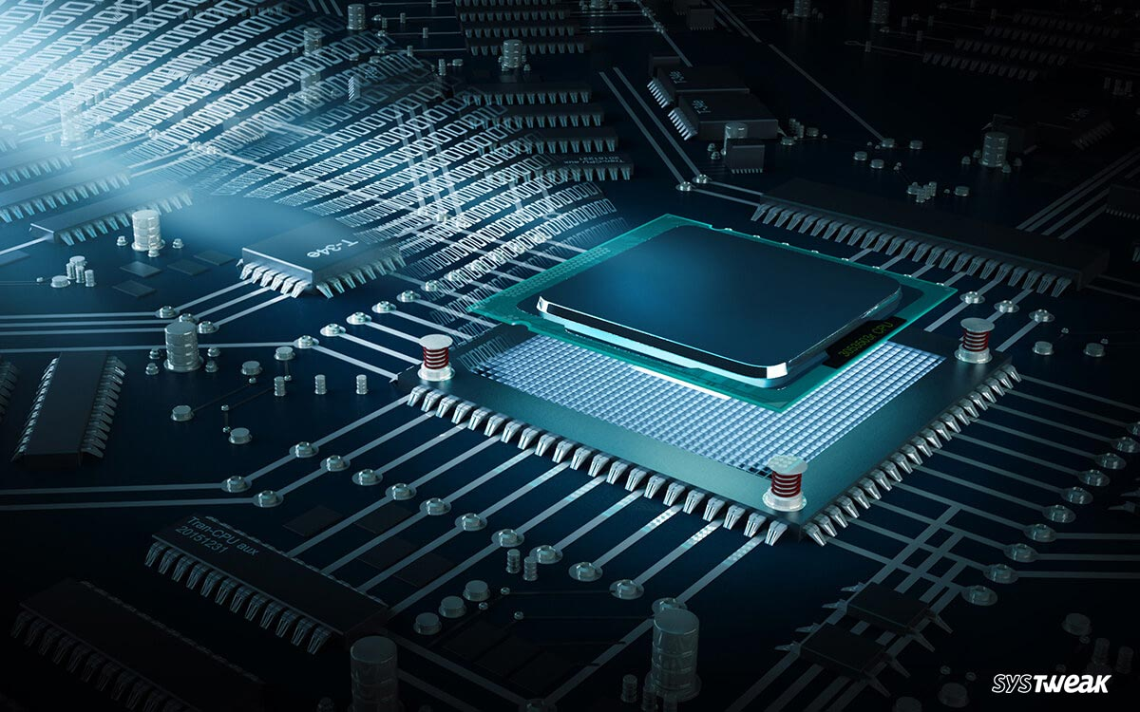
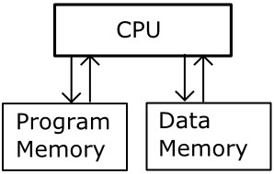
CPU – The Brain of the Computer
ALU → math & logic
Control Unit → directs flow
Registers → tiny, fast memory

Slide 4

The Bus & Motherboard
Bus = data highway (data, address, control).
Motherboard = city that holds CPU, memory, buses.

Slide 5

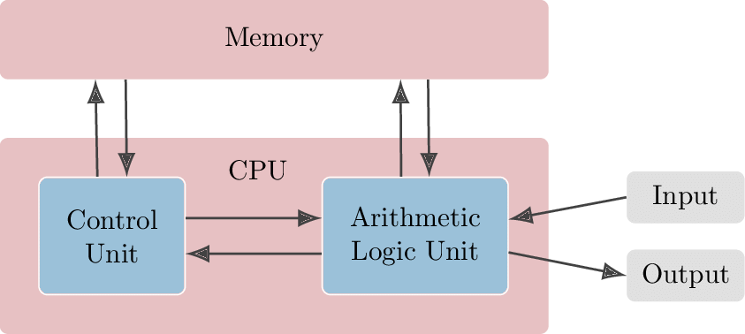
Stored-Program Concept
Von Neumann’s idea: programs + data stored together in memory.
Flexibility → one machine, many programs.

Slide 6


Slide 7


THANK YOU

